Slide 1
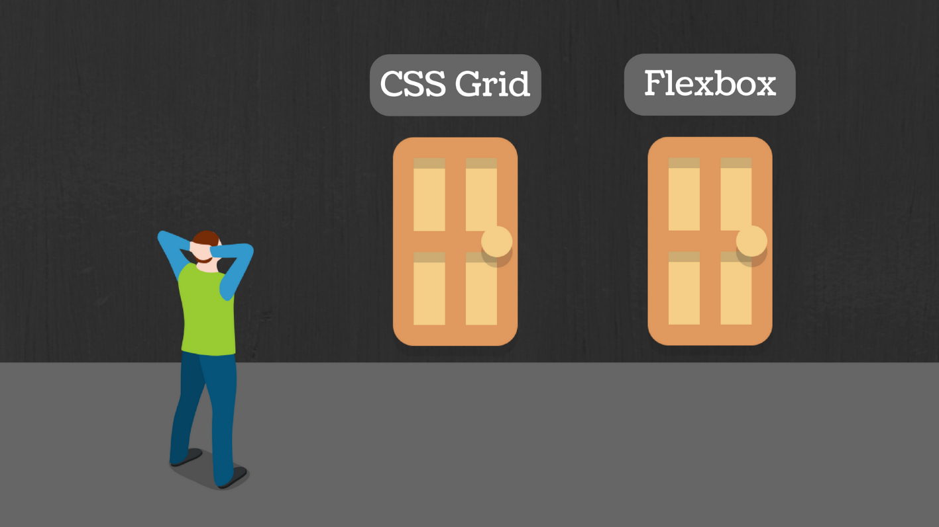
CSS FLEXBOX AND GRID

Slide 2



MEET THE TEAM:
Sushma Yedugani
Rishika Ponugoti
Nikitha Kethireddy

Slide 3
What is CSS?
"Cascading Style Sheets” are used to format the layout of Web Pages. They can be used to define text styles, table sizes, and other aspects of Web pages.
Instead of defining the style of each table and each block of text within a page's HTML, commonly used styles need to be defined only once in a CSS document. Once the style is defined in cascading style sheet, it can be used by any page that references the CSS file.
For example, a Web developer may want to increase the default text size from 10pt to 12pt for fifty pages of a Web site. If the pages all reference the same style sheet, the text size only needs to be changed on the style sheet and all the pages will show the larger text.
- Rishika

Slide 4
What is CSS FLEXBOX?
CSS Flexible Box Layout is a particular way to specify the layout of HTML pages.
One of the most defining features of the flex layout is its ability to form-fit, Flex boxes can adjust in size—either decreasing, to avoid unnecessarily monopolizing space, or increasing to make room for contents to be constrained within its boundaries.
- Rishika

Slide 5
FLEXBOX TERMINOLOGY
Following are a few properties associated with the flex layout model:
Flex container
Flex item
Flex-direction
Justify-content
Align-content
Align-self
- Rishika

Slide 6
USES OF FLEXBOX
Scaling
Flexbox is inherently good at dynamically scaling elements. When we give command display:flex; on a parent element, we can see the child elements form a nice orderly queue with matching heights.
Vertical Alignment
You can vertically align all child elements with the align-items property on the parent container by setting it to flex-start, flex-end, center, baseline, or stretch
Horizontal alignment
We can horizontally align items by setting the justify-content property to either flex-start, flex-end, center, space-between, or space-around.
- Rishika

Slide 7
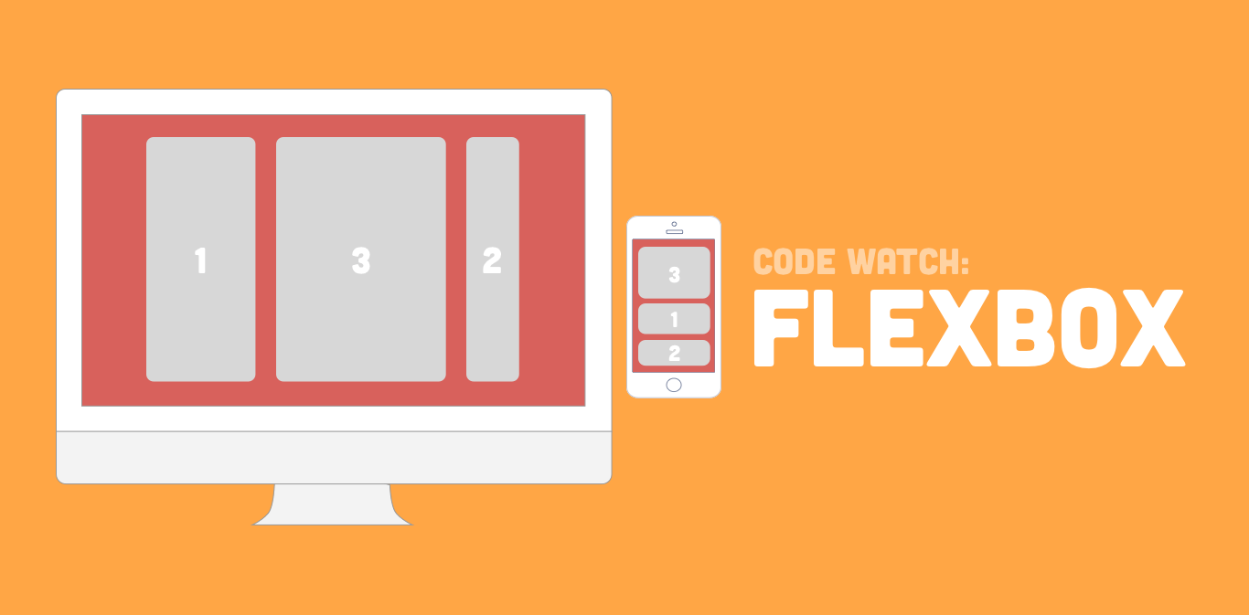
ONE DIMENSIONAL FLEXBOX
Flexbox is designed for one-dimensional layouts.
The Flexbox layout is best suited to application components and small-scale layouts.
- Rishika

Slide 8
What is CSS GRID?
CSS Grid Layout excels at dividing a page into major regions or defining the relationship in terms of size, position, and layer.
Like tables, grid layout enables an author to align elements into columns and rows. However, many more layouts are either possible or easier with CSS grid than they were with tables.
It’s very easy to make grid adapt to the available space. With each element having an area on the grid, things are not in risk of overlapping due to text size change, more content than expected or small viewports.
- Nikitha

Slide 9
GRID TERMINOLOGY
Following are a few properties associated with the grid layout model:
Grid Container
Grid Item
Grid Lines
Grid Tracks
Grid Cell
Grid Area
- Nikitha

Slide 10
EXAMPLE
HTML CONTENT
CSS CONTENT
<div id="container">
<div></div>
<div></div>
<div></div>
</div>
#container {
display: grid;
grid: repeat(2, 60px) / auto-flow 80px;
}
#container > div {
background-color: #8ca0ff;
width: 50px;
height: 50px;
}
- Nikitha

Slide 11
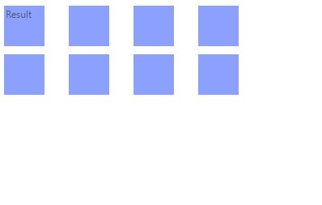
RESULT FOR THE PREVIOUS SLIDE
- Nikitha

Slide 12
USES OF GRID
Grid tracks are created within your stylesheet.
Reduced file sizes.
Prototyping with CSS Grid is fast and efficient.
- Nikitha

Slide 13
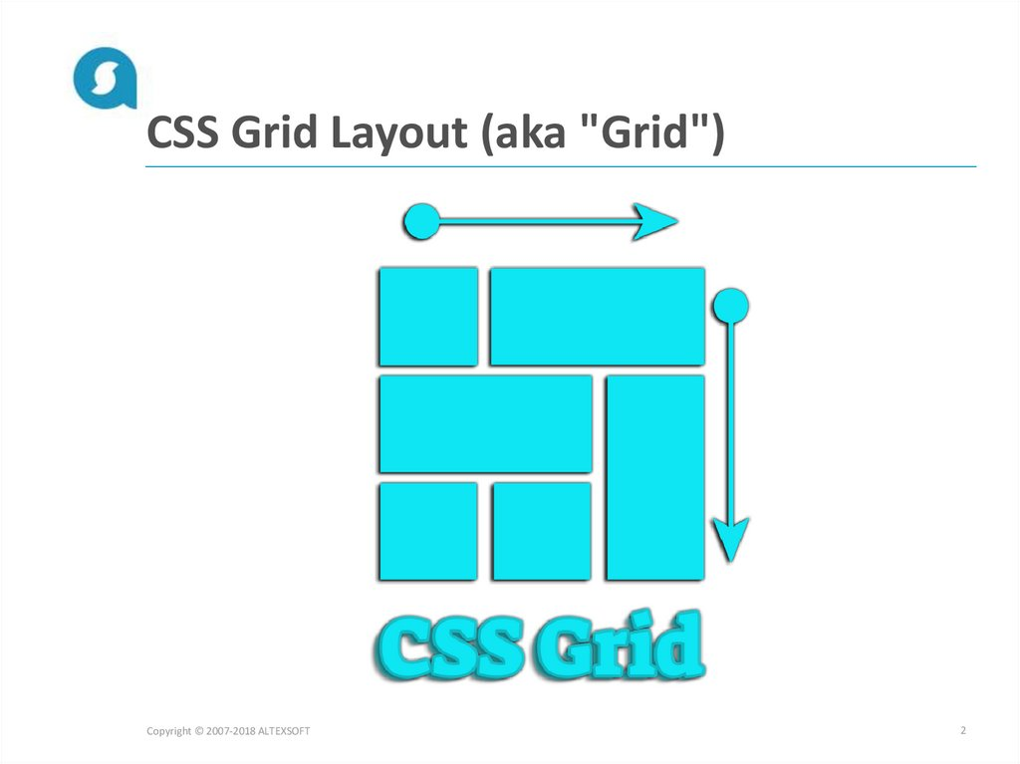
TWO DIMENSIONAL GRID LAYOUT
Grid is designed for two-dimensional layouts meaning it can handle both columns and rows.
Grid layout is designed for larger-scale layouts that are not linear in design.
- Nikitha

Slide 14
Differences Between Flex and Grid
FlexBox
Grid
Flexbox offers greater control over alignment and space distribution between items.
Flex Direction allows developers to align elements vertically or horizontally, which is used when developers create and reverse rows or columns.
Grid has two-dimension layout capabilities which allow flexible width as a unit of length.
For broader alignments in both dimensions simultaneously, CSS Grid deploys fractional measure units for grid fluidity and auto-keyword functionality to automatically adjust columns or rows.
- Sushma

Slide 15


